Slide 1
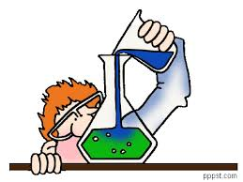
Acids & Bases
What’s the difference???

Slide 2
What is an acid?
An acid is a solution that has an excess of H+ ions. It comes from the Latin word acidus that means "sharp" or "sour".
The more H + ions, the more acidic the solution.

Slide 3
Properties of an Acid
Tastes Sour
Conduct Electricity
Corrosive, which means they break down certain substances. Many acids can corrode fabric, skin,and paper
Some acids react strongly with metals
Turns blue litmus paper red
Picture from BBC Revision Bites http://www.bbc.co.uk/schools/ks3bitesize/science/chemistry/acids_bases_1.shtml

Slide 4
What is a base?
A base is a solution that has an excess of OH- ions.
Another word for base is alkali.
Bases are substances that can accept hydrogen ions

Slide 5
Properties of a Base
Feel Slippery
Taste Bitter
Corrosive
Can conduct electricity. (Think alkaline batteries.)
Do not react with metals.
Turns red litmus paper blue.

Slide 6
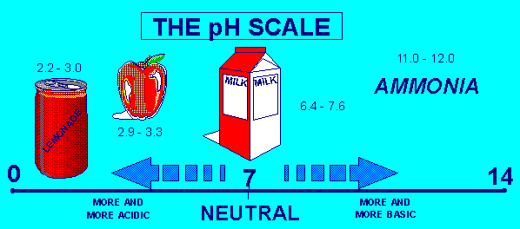
pH Scale pH = Potential Hydrogen
pH is a measure of how acidic or basic a solution is.
The pH scale ranges from 0 to 14.
Acidic solutions have pH values below 7
A solution with a pH of 0 is very acidic.
A solution with a pH of 7 is neutral / homeostasis.
Pure water has a pH of 7.
Basic solutions have pH values above 7.

Slide 7
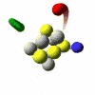
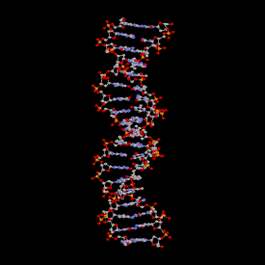
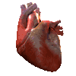
Levels of organization
Atom (oxygen)
Molecule (amino acid)
Macromolecule (DNA)
Organelle (Nucleus)
Cell (Nerve Cell)
Tissue (Muscle)
Organ (heart)
Organ system (circulatory system)
Organism (human)
http://www.coldwater.k12.mi.us/nicholsk/courses/chs/ana/levelorg.htm
smallest to
LARGEST

Slide 8
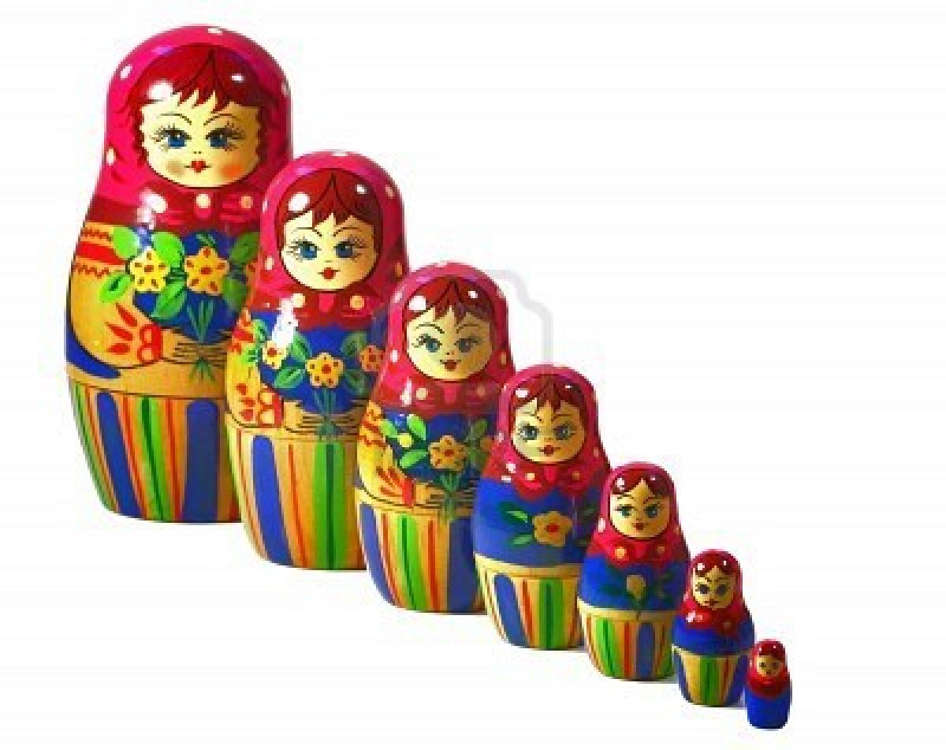
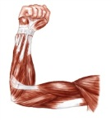
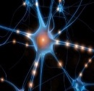
Levels of Organization of Life
Organism (You & me)
Organ System
(Circulatory System)
Organ
(Heart)
Tissue (Muscle)
Cell (Nerve Cell)
Organelle (Nucleus)
Macromolecule
(DNA)
Molecule & Compounds (Amino Acid)
Atom
(Oxygen)

Slide 9
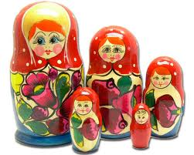
Levels of Organization: ANALOGY
In your science notebook!
Think of a “Levels of Organization” analogy in our everyday life
Organize your analogy from smallest to LARGEST! 9 levels
Example: SCHOOLS
Student, class, teacher, faculty, administration, Chandler High School, Chandler School District, Arizona schools, U.S schools

Slide 10
http://www.brainpop.com/science/matterandchemistry/acidsandbases/
BrainPop! Acids & Base

Slide 11
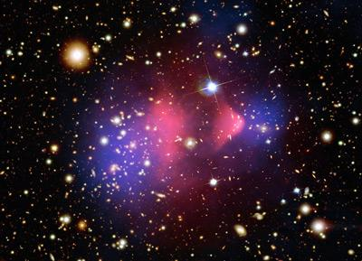
Matter vs. Energy
Matter—anything that occupies space & has mass (weight)
Energy—the ability to do work
Chemical
Electrical
Mechanical
Radiant
Notes:
END: Period 6

Slide 12
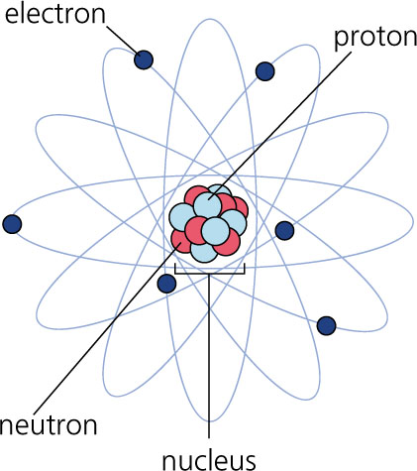
Composition of Matter
Atoms—building blocks of elements
Elements—fundamental units of matter
96% of human body is made from 4 elements
Carbon (C)
Oxygen (O)
Hydrogen (H)
Nitrogen (N)
Notes:
END: P.4

Slide 13
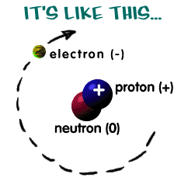
Atoms
The study of chemistry begins with the basic unit of matter…the ATOM!!
Atoms are composed of 3 main particles: (subatomic particles)
Protons (+)
Neutrons
Electrons (-)

Slide 14
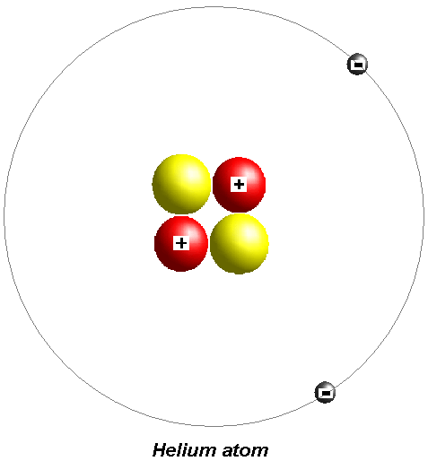
Protons and Neutrons
Strong forces bind protons and neutrons together to form the nucleus, which is at the center of the atom.
Both particles have about the same mass.

Slide 15
Electrons
Electrons are negatively charged with about 1/1840 the mass of a proton.
(Smaller than protons and neutrons)
They are in constant motion in the space surrounding the nucleus.

Slide 16
Atoms
Atoms have equal numbers of electrons and protons.
Because these subatomic particles have equal but opposite charges, atoms are neutral.

Slide 17
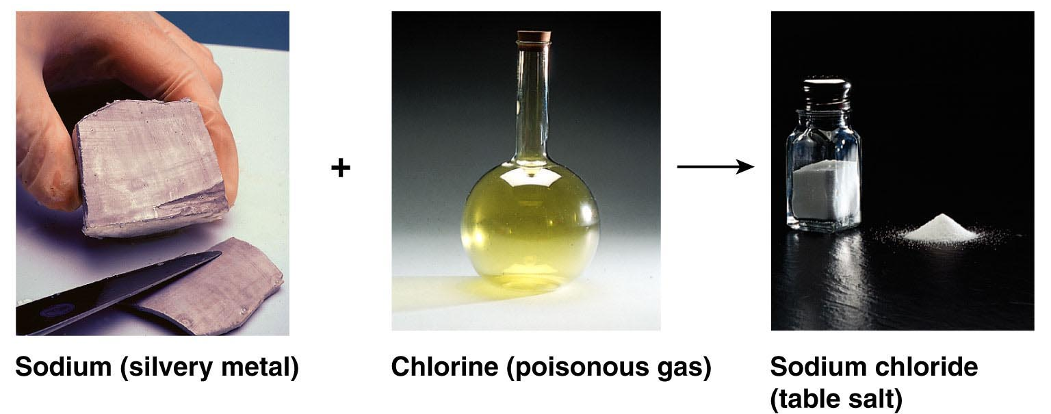
Molecules & Compounds
Molecule—2 or more like atoms combined chemically
Example: O₂ (Oxygen)
Macromolecule—very large molecule
Example: DNA
Compound—2 or more different atoms combined chemically
Example: H₂O (Water)
Figure 2.4

Slide 18
Bill Nye: ATOMS ☺
http://www.schooltube.com/video/52bb23430c9c4e0ebb74/Bill%20Nye%20-%20Atoms

Slide 19
Elements
Elements are the building blocks of all matter.
Elements cannot be decomposed into simpler matter.
Elements are made up of compounds
Group Number: 1 2 3 4 5 6 7 8

Slide 20
Atomic Number
Counts the number
of
protons
in an atom

Slide 21
Atomic Number on the Periodic Table
11
Na
Atomic Number
Symbol

Slide 22
All atoms of an element have the same number of protons
11
Na
11 protons
Sodium

Slide 23
Atomic Mass
Mass of an atom.
Approximately equal to the number of protons and neutrons
Find number of neutrons by subtracting the number of protons from the mass.

Slide 25
Review:
An element's atomic number tells how many protons are in its atoms.
An element's mass number tells how many protons and neutrons are in its atoms.

Slide 26
Learning Check 1
State the number of protons for atoms of each of the following:
A. Nitrogen
1) 5 protons 2) 7 protons 3) 14 protons
B. Sulfur
1) 32 protons 2) 16 protons 3) 6 protons
C. Barium
1) 137 protons 2) 81 protons 3) 56 protons
2) 7 protons
2) 16 protons
3) 56 protons

Slide 27
Organic Compounds

Slide 28
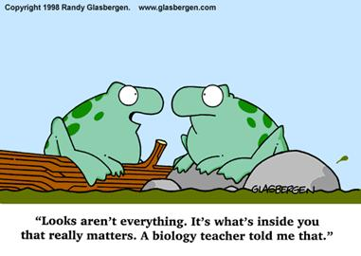

Slide 29
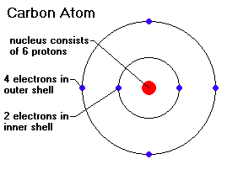
Organic Compounds
Make up most of living organisms
Contain bonds between two or more carbon atoms
C can easily bond with up to 4 other elements
4 valence electrons = 4 covalent bonds

Slide 30
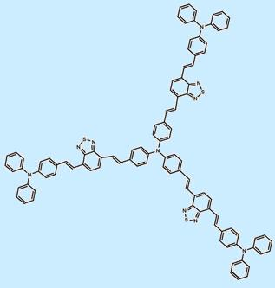
Organic Compounds
Carbon atom is versatile, can be “backbone” of long chains or rings
Organic molecules can be extremely large and complex; these are called macromolecules

Slide 31
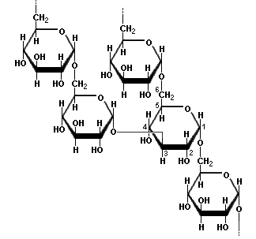
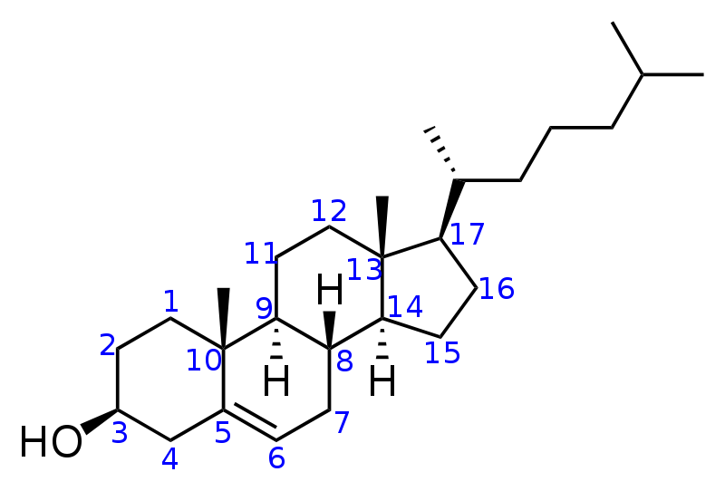
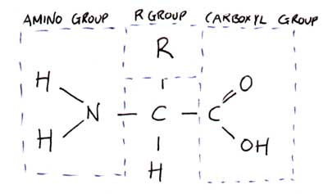
Organic Compounds
Four main types of organic macromolecules:
Carbohydrates
Lipids
Proteins
Nucleic Acids

Slide 32
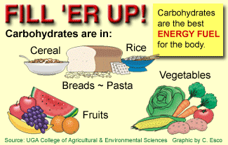
Carbohydrates
Made of C, H, & O
Main energy source for living things
Breakdown of sugars supplies immediate energy for cell activities
Extra sugar is stored as complex carbs called starches

Slide 33
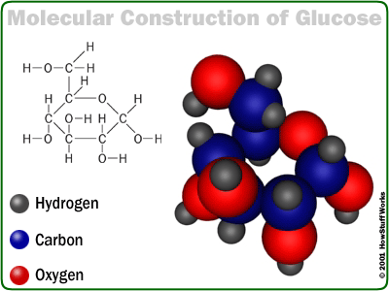
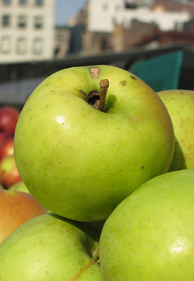
Carbohydrates
Single sugar molecules are called monosaccharides
Examples:
glucose – in many plant and animal tissues, most common monosaccharide
fructose – in many fruits
galactose – component of milk

Slide 34
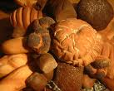
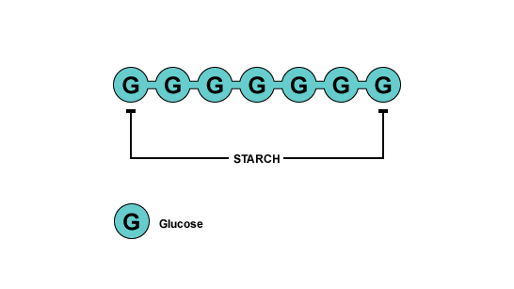
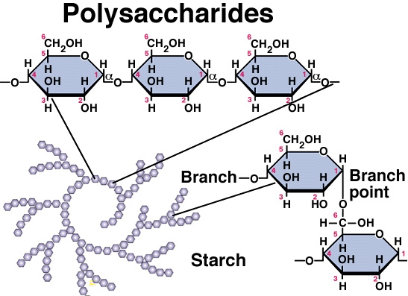
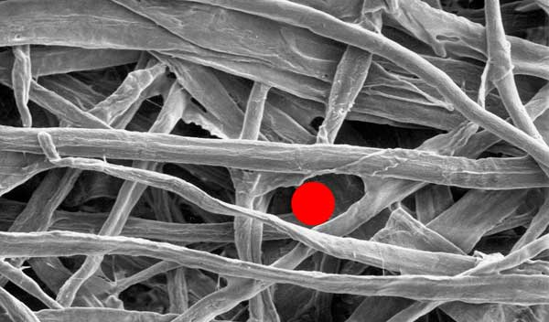
Carbohydrates
Large molecules of many monosaccharide are polysaccharides
Examples:
glycogen – animals use to store excess sugar
plant starch – plants use to store excess sugar
cellulose – fibers that give plants their rigidity & strength

Slide 35
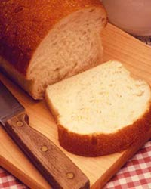
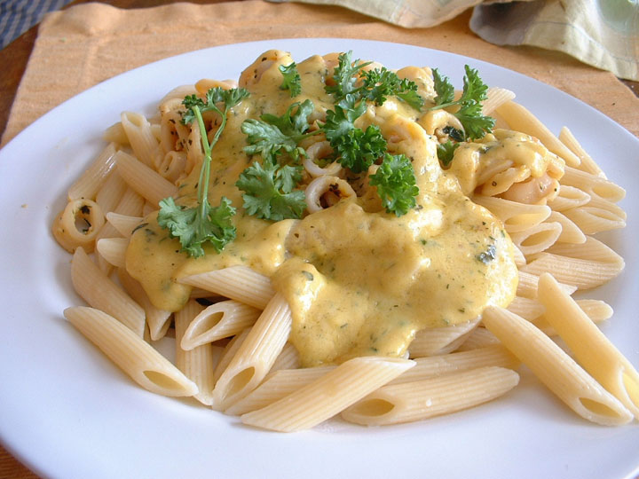
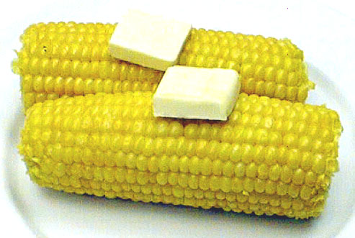
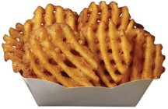

Slide 36
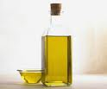
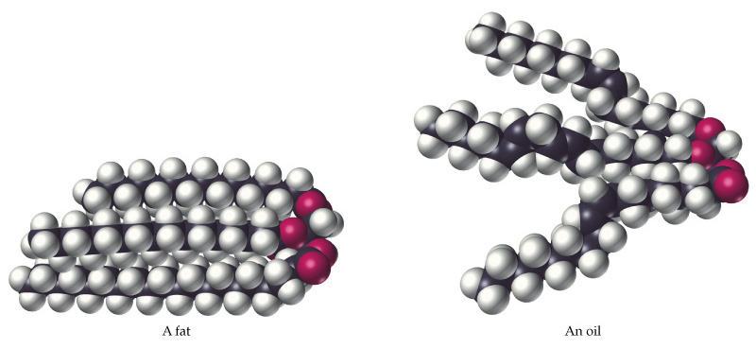
Lipids
Store more energy than CHOs because the chains are longer
Ex: Fats, oils, waxes
Won’t dissolve in water

Slide 37
Lipids
Important parts of biological membranes and waterproof coverings
Steroids are lipids that act as chemical messengers

Slide 38
Lipids
Many lipids are made from a glycerol combined with fatty acids
If all carbons have single bonds, lipid is saturated
Ex: butter, lard, animal fat (usually solid at room temperature)
If any carbons have double or triple bonds, lipid is unsaturated
Ex: vegetable oil, fish oil, peanut oil (usually liquid at room temperature)

Slide 39
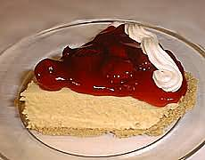
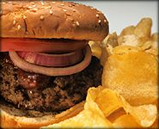
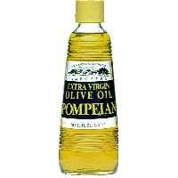
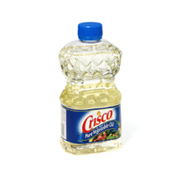
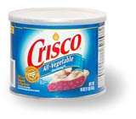
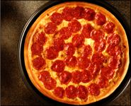

Slide 40
Proteins
Contain C, H, O, plus nitrogen
Formed from amino acids joined together
More than 20 amino acids can be joined in any order or number to make countless proteins (think of how many words can be made from 26 letters!)

Slide 41
Proteins
Chains are folded and twisted giving each protein a unique shape
Van der Waals forces and hydrogen bonds help maintain protein’s shape
Shape of protein is important to its function!

Slide 42
Proteins
Provide structure
Ex: Collagen- makes up your skin, muscles & bones
Aid chemical activities in your body
Ex: Enzymes- work to speed up rxns in your body
Transport substances into or out of cells
Help fight diseases

Slide 43
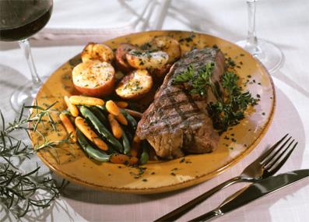
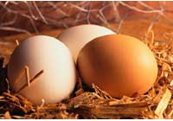
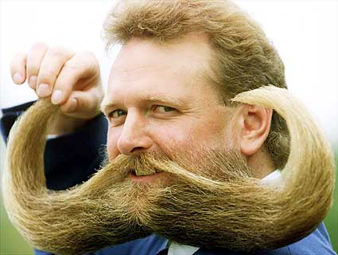
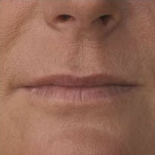

Slide 44
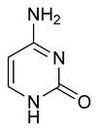
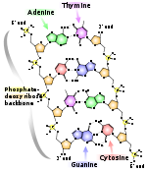
Nucleic Acids
Contain C, H, O, N plus phosphorus
Formed by bonding of individual units called nucleotides
nucleotide
Nucleic Acid

Slide 45
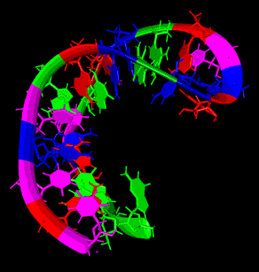
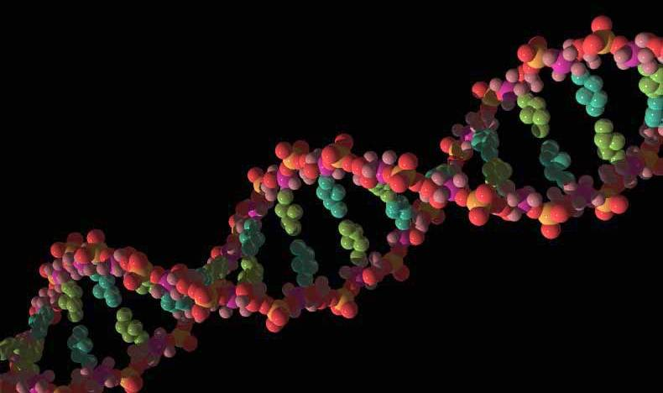
Nucleic Acids
Store and transmit hereditary information
Ex: DNA (deoxyribonucleic acid)
RNA (ribonucleic acid)

Slide 46
